Slide 1
Neutralization Curve
A neutralization curve represents the process of an acid reacting with a base (or vice versa) until the solution becomes neutral. It is commonly used in acid-base titrations to determine the concentration of an unknown acid or base. This curve graphically illustrates how pH changes as a titrant (acid or base) is added to the analyte (base or acid). Below is a detailed breakdown of its components:
1. Components of a Neutralization Curve
X-axis: Volume of titrant added (usually in mL).
Y-axis: pH of the solution.

Slide 2
2. Types of Neutralization Curves
Neutralization curves differ based on the strength of the acid and base involved:
Strong Acid vs. Strong Base:
Starts at a very low pH (acidic).
Ends at a very high pH (basic).
The equivalence point (where neutralization occurs) is at pH 7.
Weak Acid vs. Strong Base:
Starts at a moderately acidic pH.
Ends at a very high pH.
The equivalence point is above pH 7 due to the formation of a weak conjugate base.

Slide 3
Strong Acid vs. Weak Base:
Starts at a very low pH.
Ends at a moderately basic pH.
The equivalence point is below pH 7 due to the formation of a weak conjugate acid.
Weak Acid vs. Weak Base:
Starts at a moderately acidic pH.
Ends at a moderately basic pH.
The equivalence point is not sharply defined, and the curve is flatter compared to other combinations.

Slide 4
3. Important Features of a Neutralization Curve
Starting Point:
Corresponds to the initial pH of the analyte.
Determined by the strength of the acid or base present.
Buffering Region:
For weak acids or bases, there is a region where the pH changes gradually due to the presence of a buffer system.
This occurs before the equivalence point and is characterized by a slight slope in the curve.

Slide 5
3. Equivalence Point:
This is where the moles of acid equal the moles of base.
The pH at this point varies depending on the acid-base combination:
pH = 7 for strong acid-strong base titrations.
pH > 7 for weak acid-strong base titrations.
pH < 7 for strong acid-weak base titrations.
4. End Point:
The point where the indicator changes color, signaling the completion of the titration.
Ideally, this should coincide with the equivalence point.
5. Sharp Rise (or Fall):
Near the equivalence point, the pH changes rapidly with the addition of very small amounts of titrant.

Slide 6
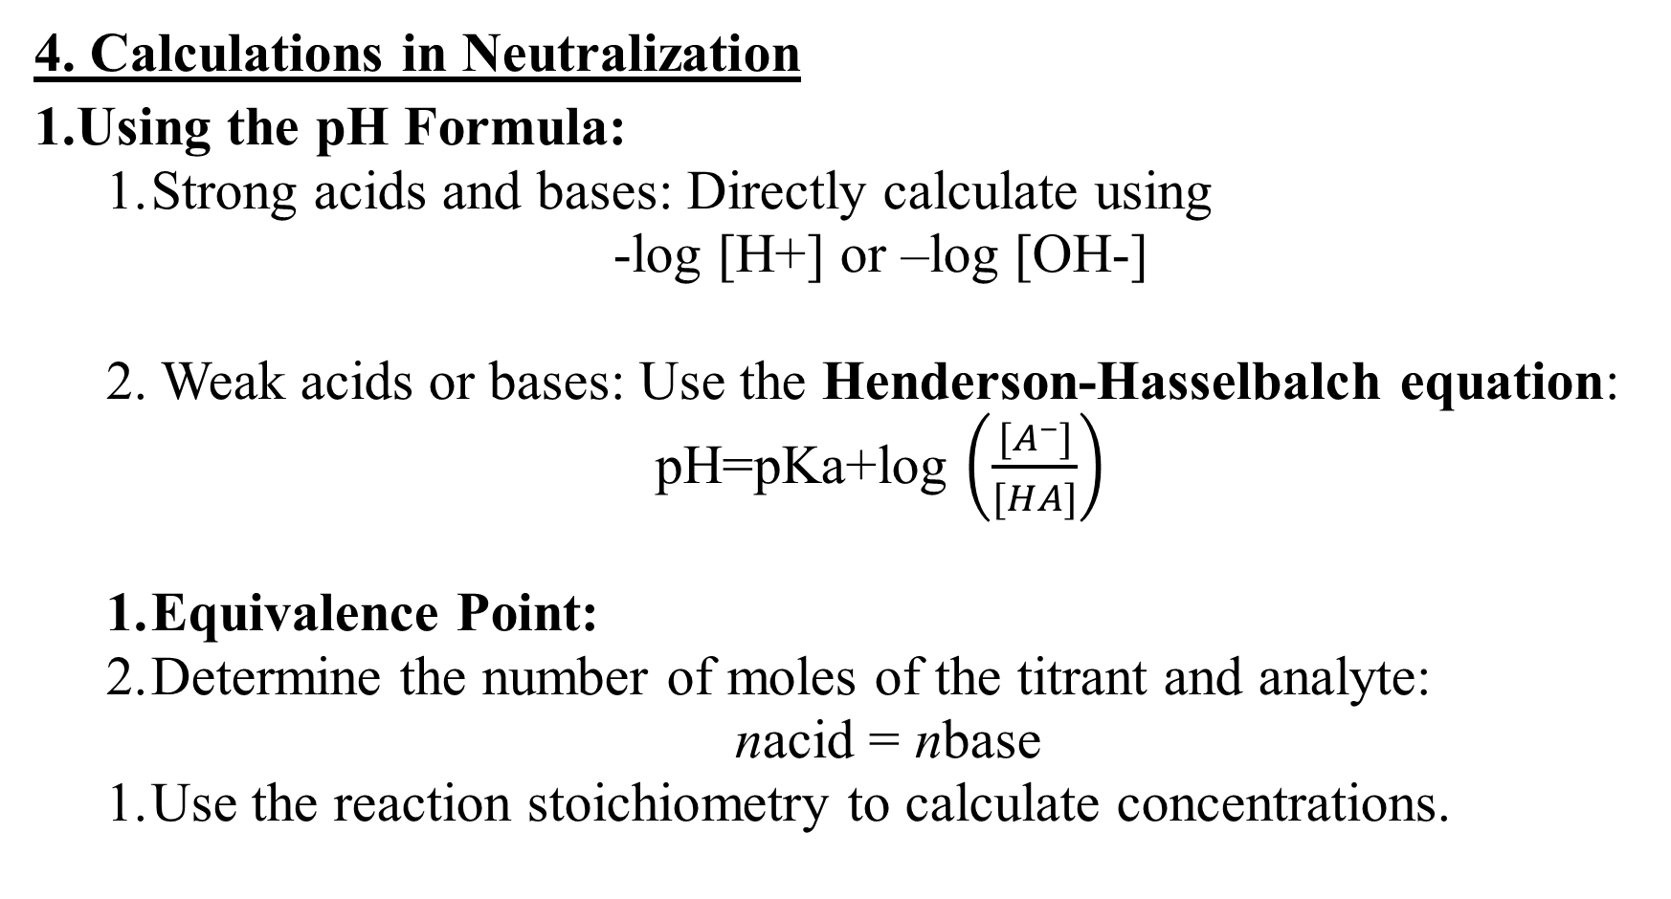
4. Calculations in Neutralization
Using the pH Formula:
Strong acids and bases: Directly calculate using
-log [H+] or –log [OH-]
2. Weak acids or bases: Use the Henderson-Hasselbalch equation:
pH=pKa+log $\left(\frac{[A−]}{[HA]}\right)$
Equivalence Point:
Determine the number of moles of the titrant and analyte:
nacid = nbase
Use the reaction stoichiometry to calculate concentrations.

Slide 7
5. Indicators in Neutralization
Indicators are chosen based on the expected pH at the equivalence point.
Phenolphthalein: Suitable for strong acid-strong base or weak acid-strong base (changes color around pH 8.2-10).
Methyl orange: Suitable for strong acid-weak base (changes color around pH 3.1-4.4).

Slide 8
6. Applications of Neutralization Curves
Determining the concentration of unknown acids or bases.
Studying the properties of weak acids or bases.
Formulating buffer solutions.
Quality control in industries.

Slide 9
1. Strong Acid vs. Strong Base
Example: HCl (acid) titrated with NaOH (base).
Features:
Starting Point: The pH is very low, typically close to 1, since strong acids completely dissociate in water.
Curve Behavior:
The pH increases slowly as NaOH is added because the solution is acidic.
Near the equivalence point, the curve rises sharply, reflecting the rapid change in pH with small additions of the base.

Slide 10
Equivalence Point:
pH = 7 at equivalence.
At this point, HCl and NaOH completely neutralize, forming water and a neutral salt (NaCl).
After Equivalence Point:
The solution becomes basic, with the pH rising steeply and leveling off as excess NaOH dominates.
Curve Shape:
Symmetrical "S" shape with a steep vertical region at pH 7.

Slide 11
Calculate the pH of the solution when 25 mL of 0.1 M HCl is mixed with 25 mL of 0.1 M NaOH.
Step 1: Write the balanced chemical equation
The reaction between HCl (a strong acid) and NaOH (a strong base) is:
HCl + NaOH→ NaCl + H2O
Step 2: Calculate the moles of HCl and NaOH
Moles of HCl = Molarity × Volume (in L)=0.1×0.025=0.0025
Moles of NaOH= 0.1×0.025 = 0.0025

Slide 12
Step 3: Determine the limiting reactant
Since the moles of HCl and NaOH are equal, they completely neutralize each other.
Step 4: Find the nature of the resulting solution
After complete neutralization:
No excess HCl or NaOH remains.
The solution contains only water and NaCl (a neutral salt).
Step 5: Calculate the pH
Since the solution is neutral, the pH is:
pH=7

Slide 13
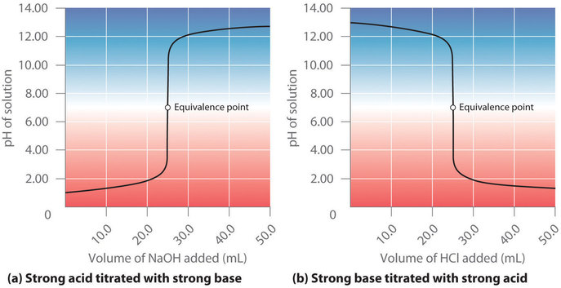
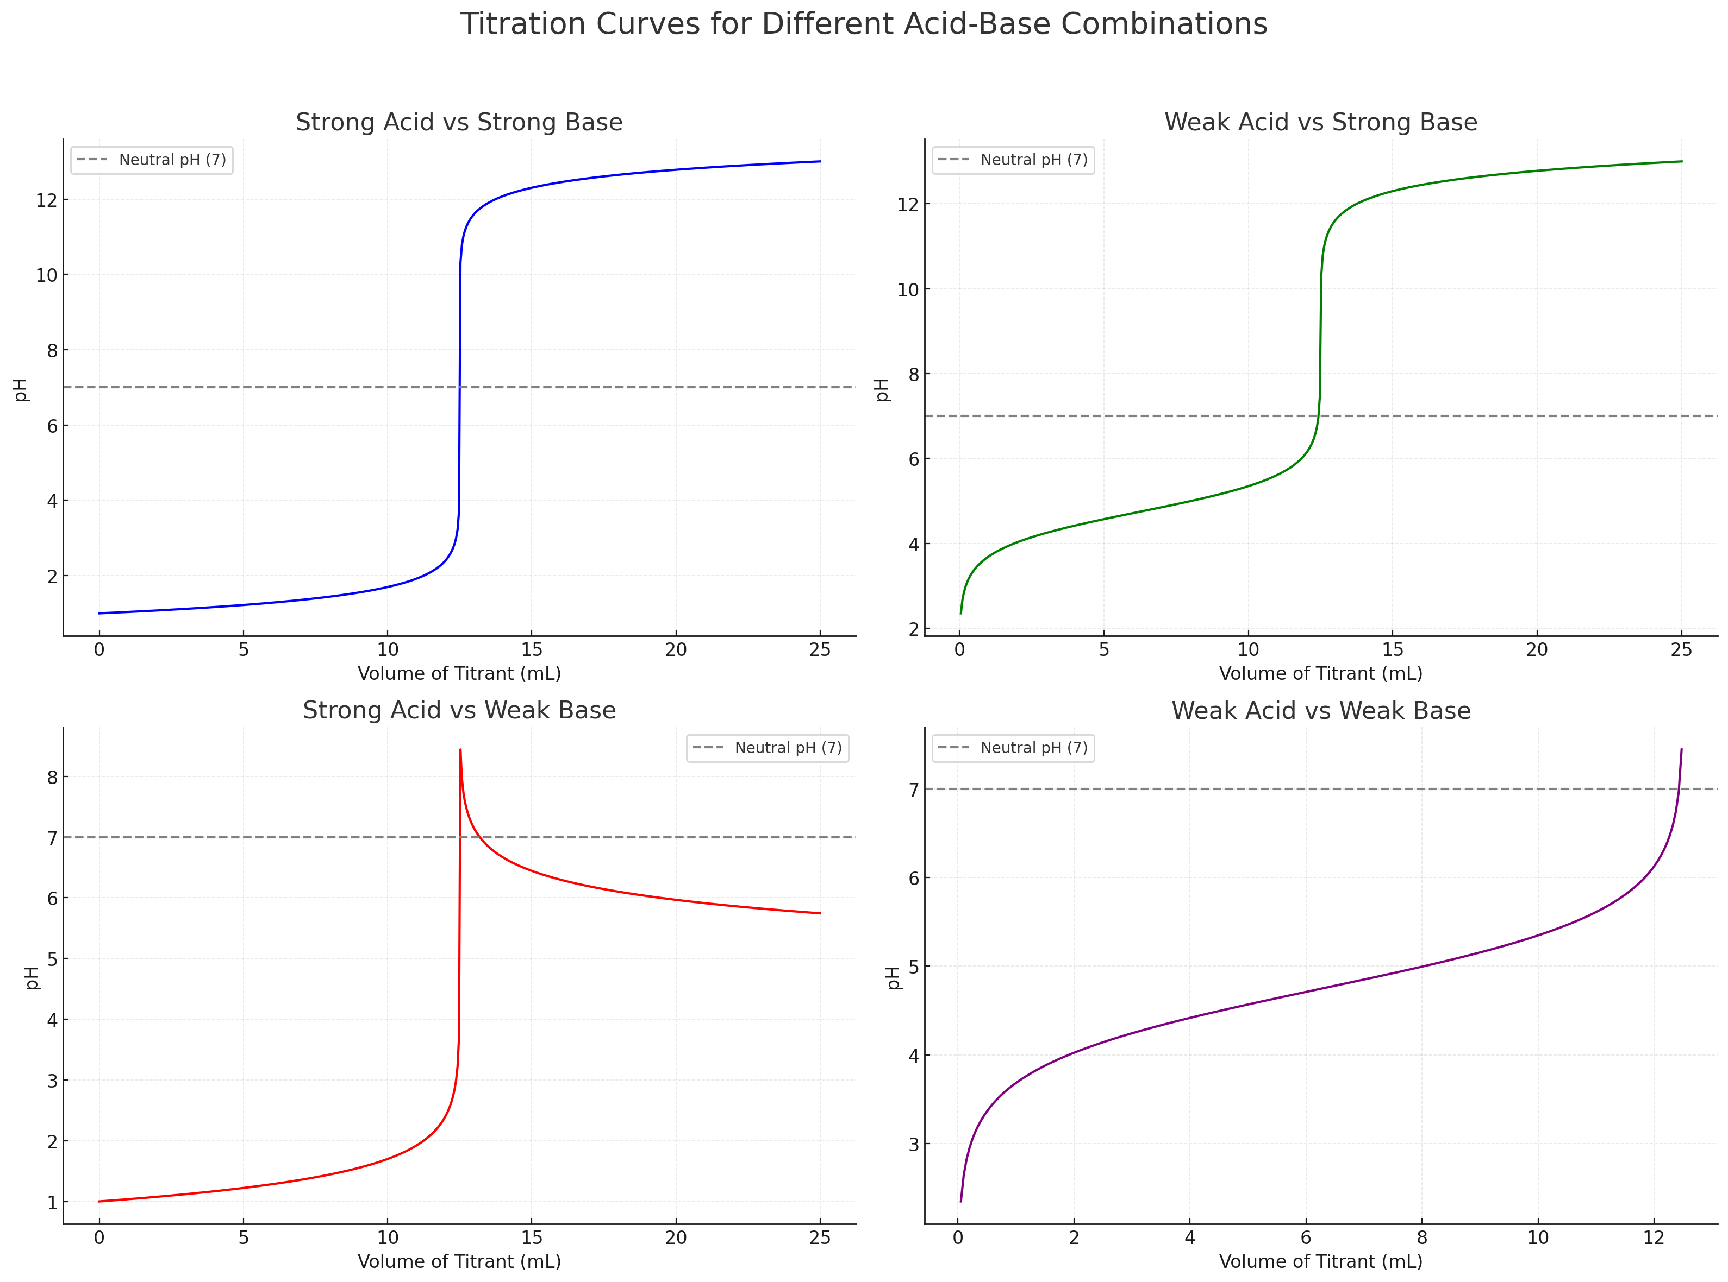

Slide 14
2. Weak Base vs Strong Acid
Example: HCl titrated with NH₃ (ammonia).
Features:
Starting Point: The pH is very low (around 1-2), as HCl is a strong acid.
Buffering Region:
As NH₃ is added, it reacts with H⁺ ions to form ammonium ions (NH₄⁺), creating a weak acid buffer.
The pH rises gradually in this region.
Equivalence Point:
pH < 7 (typically around 5-6) because the ammonium ion (NH₄⁺) is slightly acidic, and it hydrolyzes to release H⁺ ions.

Slide 15
After Equivalence Point:
The pH levels off more slowly compared to a strong base because excess NH₃ is a weak base.
Curve Shape:
Steady rise at the start, buffering region, and a less steep rise at equivalence compared to strong acid-strong base.

Slide 16
Calculate the pH when 50 mL of 0.1 M HCl is mixed with 25 mL of 0.1 M NH₃. The 𝐾_{𝑏}​ for NH₃ is 1.8×10⁻⁵ .
Step 1: Write the balanced chemical equation
HCl + NH₃ → NH₄Cl
HCl (strong acid) reacts completely with NH₃ (weak base) to form NH₄⁺ (ammonium ion), which is acidic.
Step 2: Calculate the moles of HCl and NH₃
Moles of HCl = Molarity × Volume (in L)=0.1 × 0.05 = 0.005 moles
Moles of NH₃ = 0.1 × 0.025 = 0.0025 moles

Slide 17
Step 3: Determine the limiting reactant
Moles of NH₃ = 0.0025 (completely reacts with HCl).
Excess HCl= 0.005 − 0.0025= 0.0025 moles
The reaction forms 0.0025 moles of NH₄⁺ and leaves no NH₃.

Slide 18
Step 4: Calculate the concentration of NH₄⁺ and excess HCl
The total volume of the solution is:
Total Volume = 50 mL + 25 mL = 75 mL = 0.075 L
Concentration of excess HCl:
[HCl] = Excess moles of HCl / Total volume = 0.0025 / 0.075 = 0.0333 M
Concentration of NH₄⁺:
[NH₄⁺] = Moles of NH₄⁺ / Total volume = 0.0025 / 0.075 = 0.0333 M

Slide 19
Step 5: Calculate the contribution to pH
Since HCl is in excess and a strong acid, its contribution dominates the pH. The hydronium ion concentration is:
[H+] = [HCl] = 0.0333 M
pH = −log⁡ [H+] = −log⁡(0.0333)
pH ≈ 1.48

Slide 20
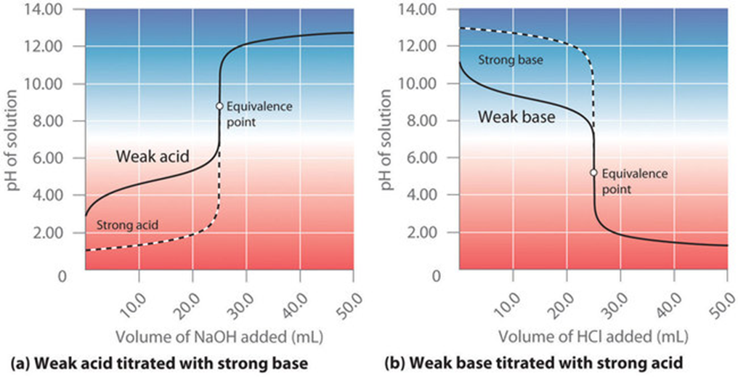

Slide 21
3. Weak Acid vs. Strong Base
Example: Acetic acid (CH₃COOH) titrated with NaOH.
Features:
Starting Point: The pH is moderately low (around 2-3) because weak acids do not fully dissociate.
Buffering Region:
As NaOH is added, the acetic acid reacts to form acetate ions (CH₃COO⁻), creating a buffer system.
In this region, the pH increases gradually, as the solution resists changes in pH due to the buffer effect.

Slide 22
Equivalence Point:
pH > 7 (typically around 8-9) because the conjugate base (CH₃COO⁻) hydrolyzes, making the solution slightly basic.
After Equivalence Point:
The pH rises steeply and levels off as excess NaOH dominates.
Curve Shape:
Gradual slope at the start, a buffer region, and a steep rise at equivalence.

Slide 23
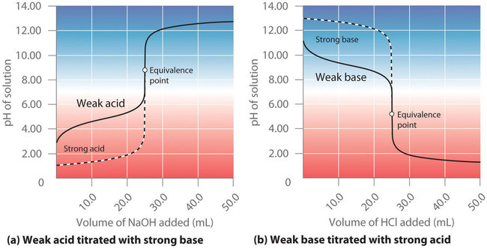

Slide 24
4. Weak Acid vs. Weak Base
Example: Acetic acid (CH₃COOH) titrated with ammonia (NH₃).
Features:
Starting Point: The pH starts at a moderately low value (around 3-4), as the weak acid is only partially dissociated.
Buffering Region:
Both the acid and base contribute to a complex buffer system.
The curve is relatively flat in this region due to the buffering effect.
Equivalence Point:
The pH depends on the relative strengths of the weak acid and weak base.
If they are of equal strength, the pH is around 7. Otherwise, it may lean slightly acidic or basic.

Slide 25
After Equivalence Point:
The curve levels off slowly due to the weak base.
Curve Shape:
Broad, less steep overall, with no sharp inflection point.

Slide 27
